Slide 1

ML – SPRINT HACKATHON
TEAM: ML-Enthusiasts
Tanzeel Khan – 20MIM10148
Ayush Kesarwani - 20MIM10138
Tushar Mishra - 20BHI10028
Rajat Gore – 20BAI10184

Slide 2

Problem Statement
Grouping customers into ideal number of clusters:
Develop a model to visualize data from mall customers and cluster them into ages and potential products purchased.

Slide 3
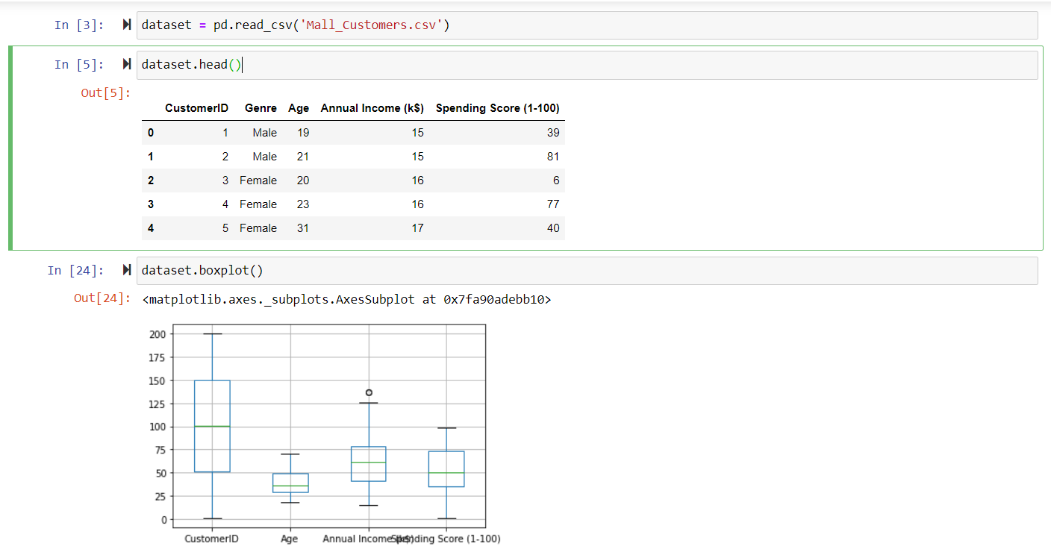
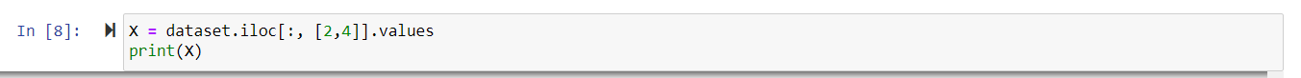
Data Exploration
We concluded that we can apply K-means clustering for the customer segmentation

Slide 4
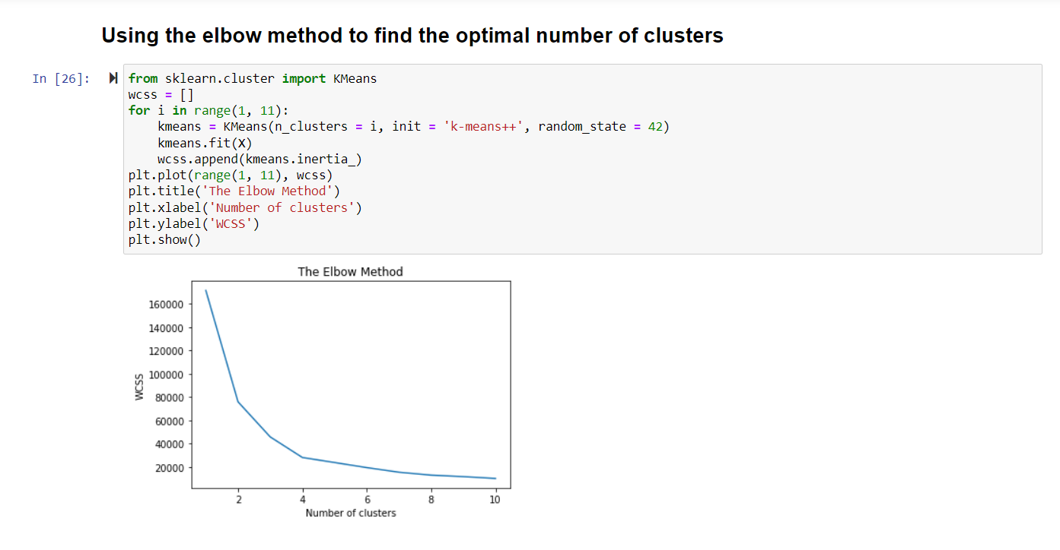
So , now we use the elbow method to find the optimal number of Clusters.
Which in this case comes out to be 4.

Slide 5
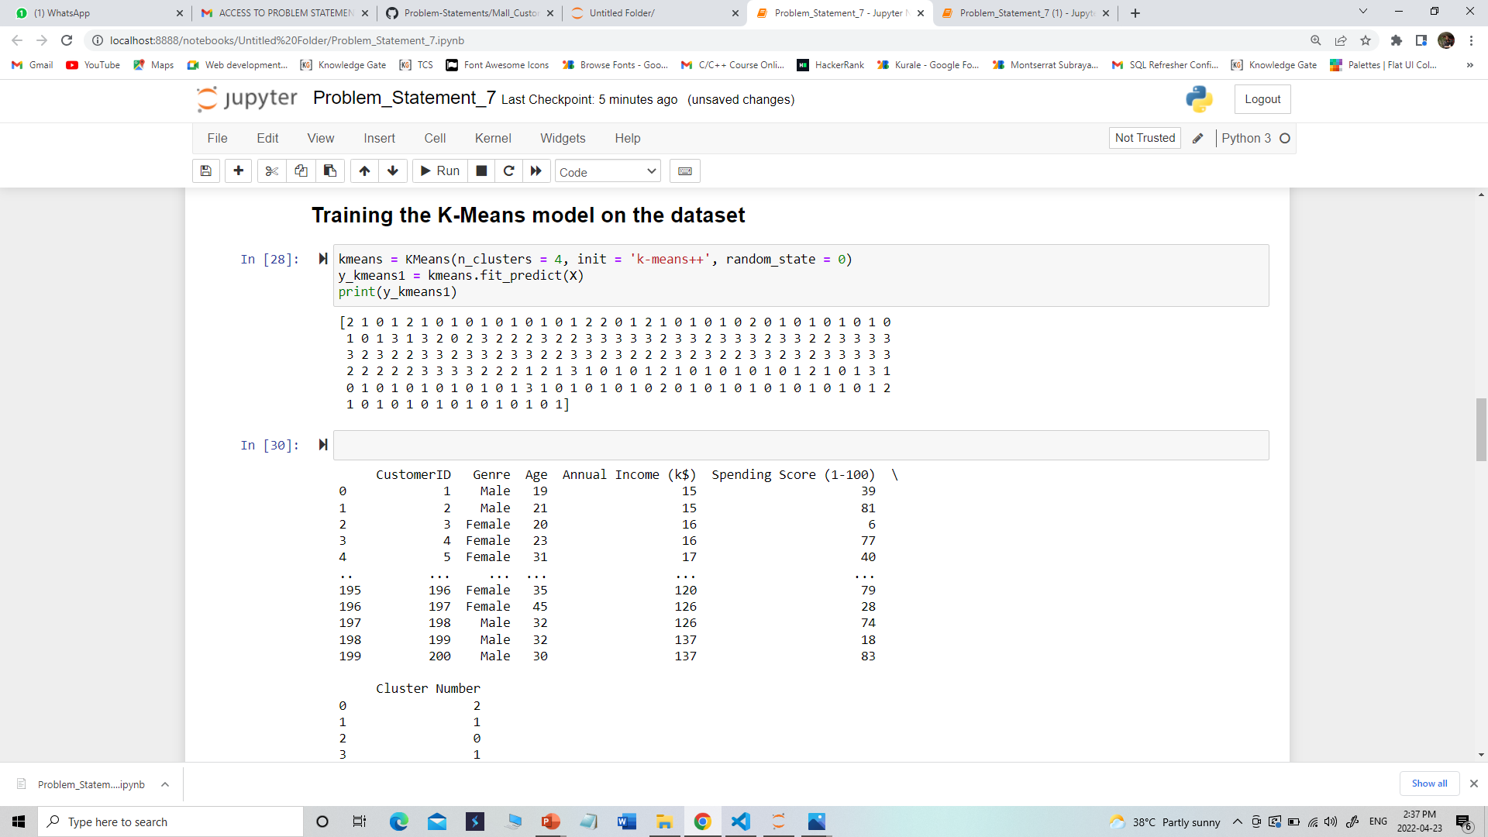
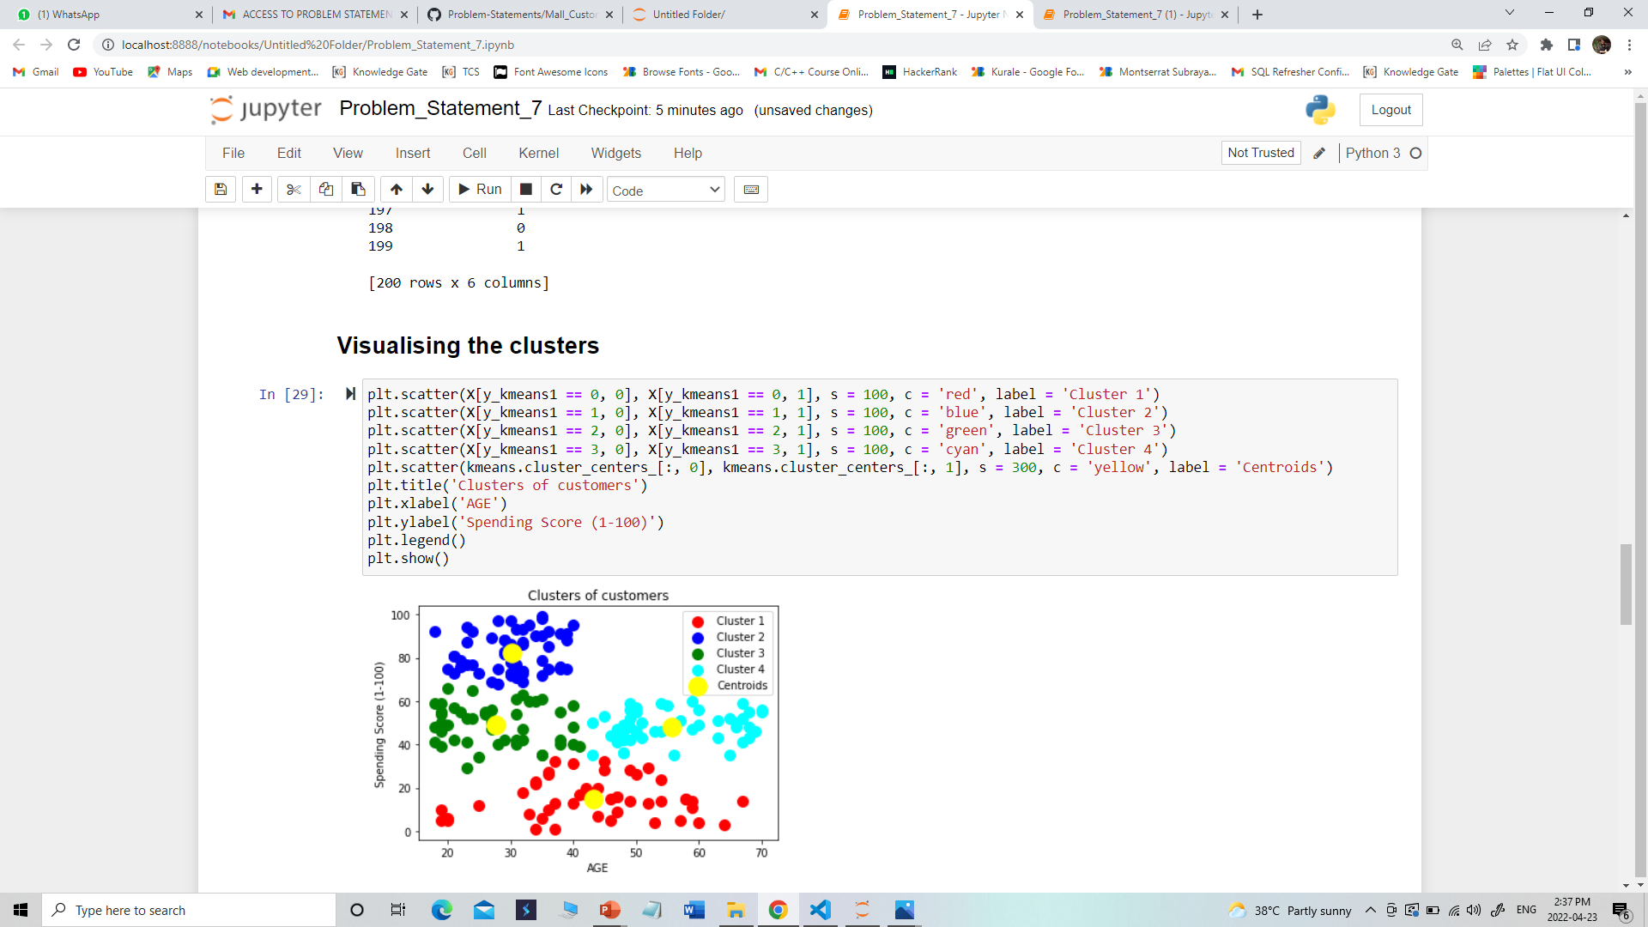

Slide 6
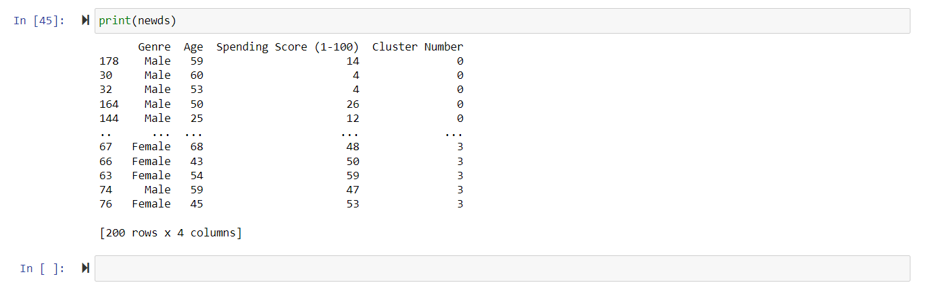
After finding the clusters, we filtered our dataset.

Slide 7
Conclusion
In this problem, we tried to find out the clusters, so that we can group the data of customers visiting malls on the basis of their age and how much they spent.
It is one of the useful insights for the corporates. Using this data in the developing regions, we can compare and contrast the business opportunities available out there.
We finally got a useful trending data which finds many applications in the modern world.
This is a simple demonstration on a small dataset, which can be expanded and applied to the actual available data on trends in the shopping places, here we provided a simple procedure to conduct an analysis on the data and find the valuable insights so as to apply in the real world.

